Slide 1
Development of Nanoscaffolds Through Oxidation on Titanium-Alloy Disks to Increase Artificial Implant Lifespan
URITC-UPRM Eisenhower Fellowship 2009
Caitlyn M. Maleck
University of Rhode Island
Mechanical Engineering Undergraduate
July 17, 2009

Slide 2
Agenda
Introduction and Background
Methodology
Results
Preliminary Conclusions

Slide 3

Introduction & Background
Titanium alloys commonly used in implants
Loosening of the implant can lead to future surgeries
Solution:
Objective: determine a method for creating uniform nanoscaffolds on various titanium alloys to maximize area and reduce oxide fracture

Slide 4
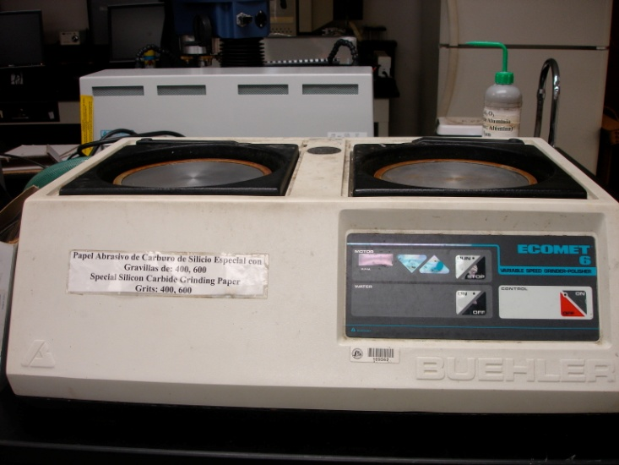
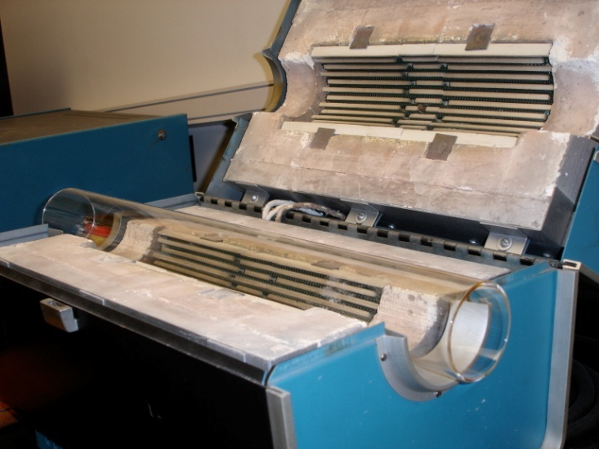
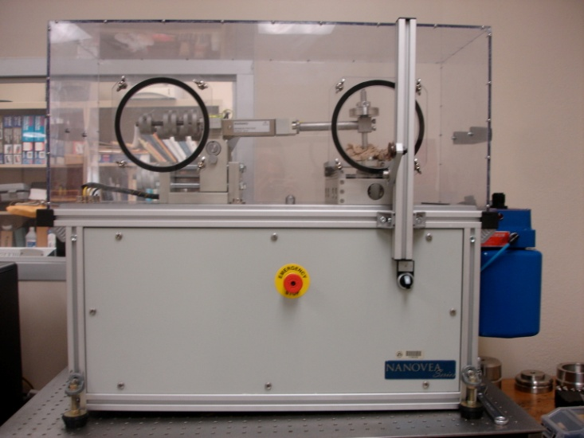
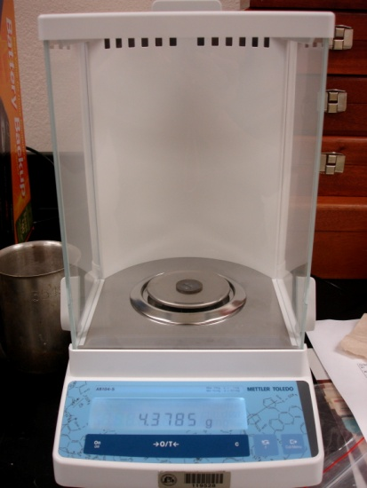
Methodology
Figure 1: (Above) Samples polished with
conventional Beuhler pads up to 600 grit.
Figure 2: (Above) Tubular oven used to allow
a continuous airflow to facilitate oxidation.
Figure 3: (Above) Tribometer used for linear wear
testing on disks on each of 5 patterned oxidized lines.
Figure 4: (Above) Mass lost was measured after
every test with a 5-digit weighing scale.

Slide 5
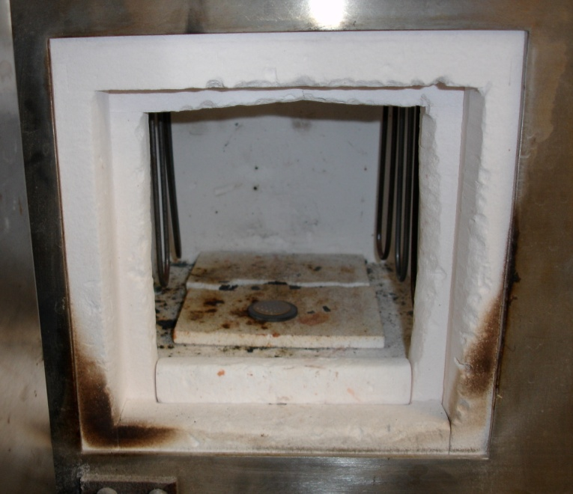
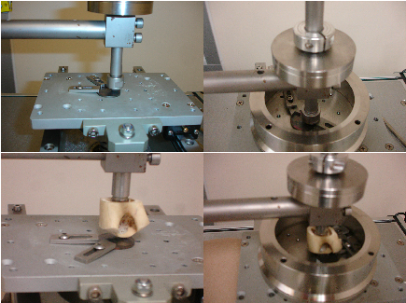
Revised Methodology
Only the Ti-6Al-4V alloy disks were used
Polished again up to 600 grit
Masses recorded immediately after each test
Figure 5: (Below) Conventional oven used at 650ºC for 1 hr.
Figure 6: (Above) Four types of tribology tests used.

Slide 6
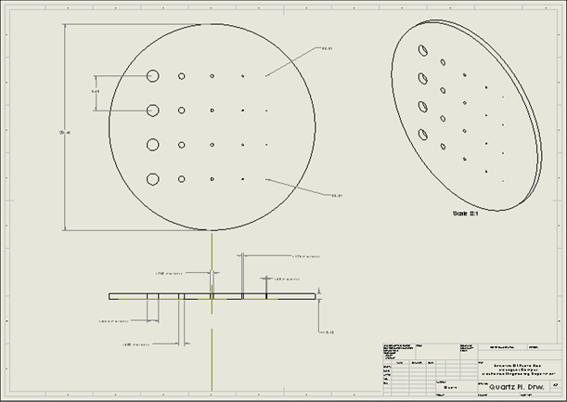
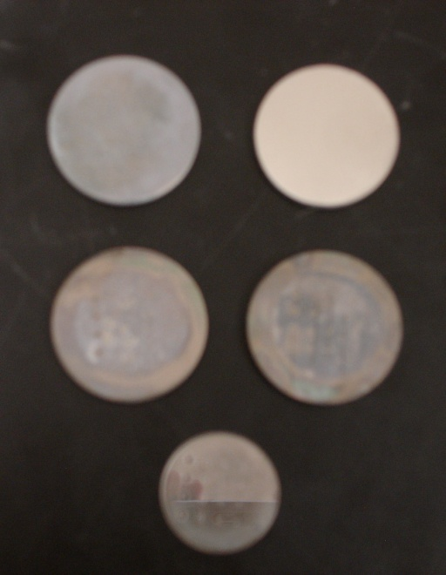
Results
Patterns on all four disks created by oxidation were visible
Each placed in the tribometer under four different conditions for 5 minute intervals
Figure 7: (Above left) Progression of Ti-alloy disks. (Clockwise starting from top left) Non-polished, polished to 600 grit, after oxidation, array mask used during oxidation, after tribology.
Figure 8: (Above right) CAD drawing of array mask designed by Carlos R. Ramos-Sáenz.

Slide 7
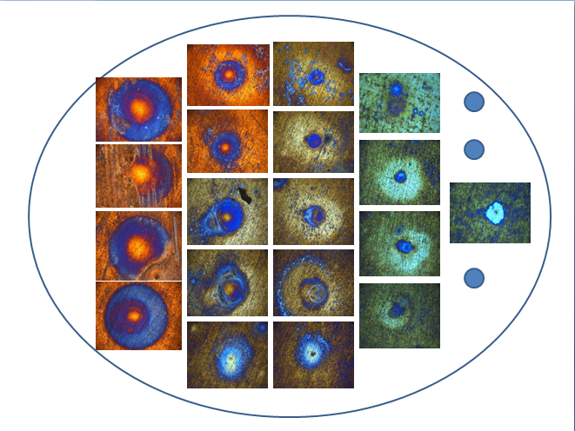
Figure 9: Demonstration of nanoscaffolds under microscope.
Output for tribology tests transferred to Excel where data was processed in a MATLAB program
Trend line is moving average of peak points during tests
  Black: 1mm diameter (1000 microns)
  Orange: 500 microns
  Blue: 250 microns
  Green: 125 microns
  Purple: 35 microns

Slide 9
Mean Mass Gain

Slide 10
Mean Mass Loss

Slide 11
Original Tribology Tests of
Ti-6Al-4V Alloys

Slide 12
Preliminary Conclusions
Most efficient alloy was Ti-6Al-4V alloy in the conventional oven at 650ºC for 1 hr.
Wear was audible and visible, on custom bone pin and alloy disks
Coef. of friction increased when tested against SS in both environments
Lubricated study of bone pin had coef. of friction about 1 compared to dry environment and coef. of friction of about 1.2
For SS, the coef. of friction is dependent on size of scaffold
For bone, there is no dependency for coef. of friction and size of scaffold

